Slide 1
Data Science Fundamentals
CREDIT HOURS 3(2,1)
INSTRUCTOR: JUNAID ALI KHAN

Slide 2
Course Evaluation
4 Quizzes (15T)
4 Assignments (10T)
Mid-term (25T)
Lab Tasks/Lab Assignments (25L)
Lab Mid-term (25L)
1 Lab Project (50L)
Terminal Exam (50T)
Attendance (80%)

Slide 3
Course Description
Course Syllabus, CDF and CLO’s.

Slide 4
Lecture 1

Slide 5
Data Science?
Process of extracting knowledge and insights from the complex and large set of data by using processes like data cleaning and data visualization.
Example?
Google

Slide 6
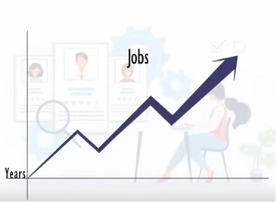
Required Data Science Techniques
Deep learning – 11%
Clustering – 11%
Predictive modeling – 8%
Neural networks – 5%
Natural language processing (NLP) – 5%
Scikit-learn – 4%
Decision trees – 3%
A/B testing – 2%

Slide 7
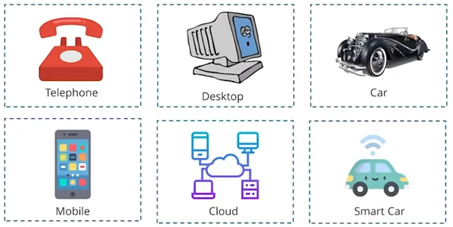
Data Sources
Evolution of Technology

Slide 8

Data Sources
IoT Data

Slide 9
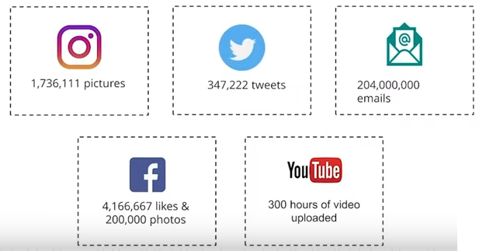
Data Sources
Social Media

Slide 10
Buzz Words Related to Data
Data Engineering / Data Engineer
Data Science / Data Scientist
Data Analyst

Slide 11
Data Analyst vs Data Scientist
Data Analyst | Data Science
Works with structured data. | Works with structured and unstructured data.
Analyzing the existing data and extracting information (no prediction) | Prediction and forecasting
Business Intelligence tools like PowerBI and Tableau. | Develop models (need skills like ML & DL)
Excel & Creating Dashboards. | Frameworks like Sklearn, Pytorch, keras and Tensorflow.

Slide 12
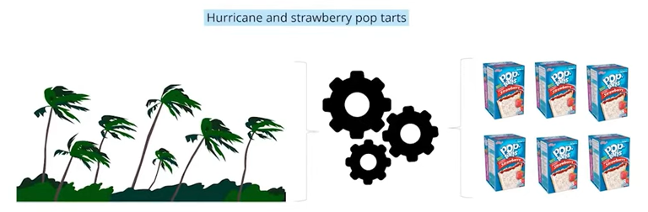
Data Use Case 1 (Walmart)

Slide 13
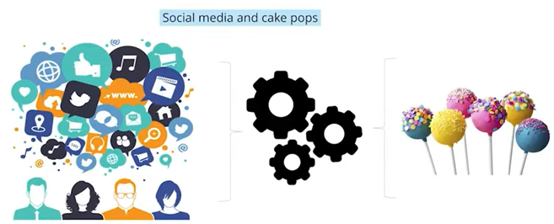
Data Use Case 2

Slide 14
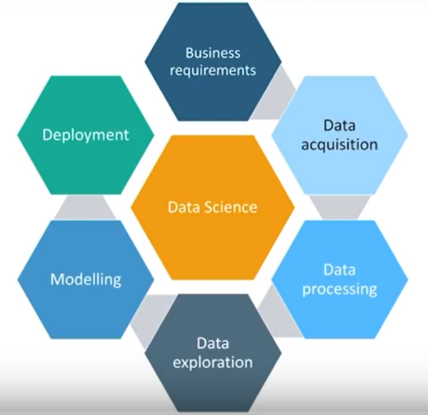
Data Life Cycle

Slide 15
What is Data (Statistics)
Data refers to facts and statistics collected together for analysis.
Data can be….
Collected/stored
Measured
Analyzed
Visualized

Slide 16
Categories of Data 1. Qualitative Data
Type of data, which deals with the characteristics that can’t be easily measured but can be observed subjectively.
Nominal Data
Ordinal Data

Slide 17
Nominal vs Ordinal Data
Data with no order or ranking such as gender, race or mode of transportation is known as Nominal data. | Data with an ordered series, like order ids (below shown table) is known as Ordinal data.
For Example: (Gender) Male | For example: (Id , Rating) 001 | Good
Female | 002 | Bad
 | 003 | Average

Slide 18
Categories of Data 2. Quantitative Data
Type of data, which deals with numbers and things, you can measure objectively.
Discrete Data
Continuous Data

Slide 19
Discrete vs Continuous Data
Also called as Categorical Data. It can hold finite number of possible values. | Data that can hold finite number of possible values.
For Example: Number of students in a class. | For example: Weight of a person or temperature.

Slide 20
Statistics
Area of applied mathematics concerned with the data collection, analysis, interpretation and presentation.
For example; Business sales report

Slide 21
Basic terminologies in statistics
Population → A collection or set of individuals, whose properties are to analyzed.
Sample → A subset of population is called as “Sample”. A well-chosen sample will contain most of the information about a particular population.

